Slide 1
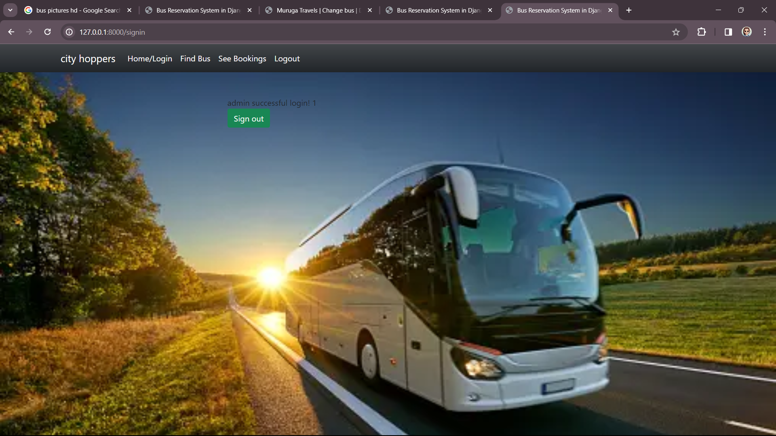
ADMIN PAGE

Slide 2
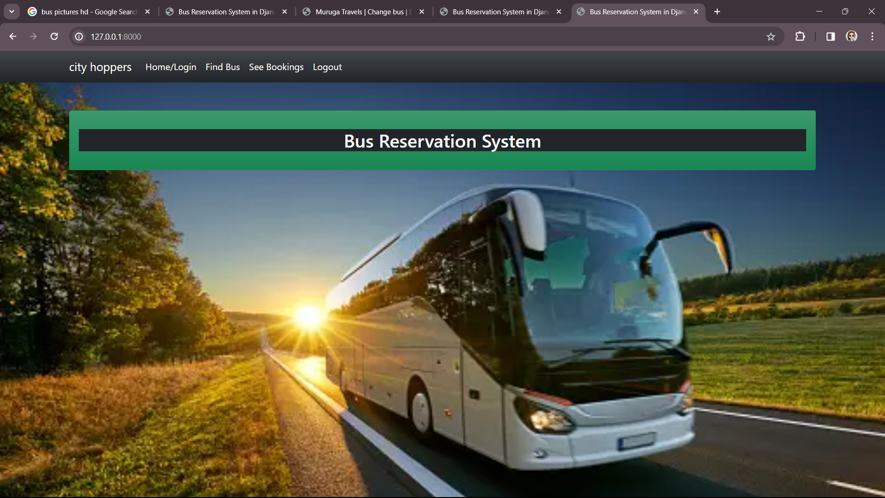
HOME PAGE

Slide 3
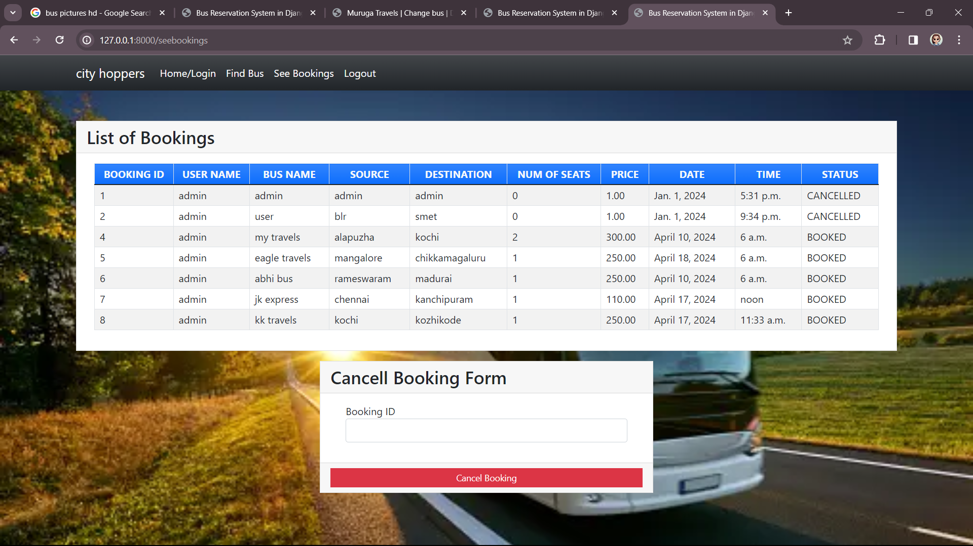
BOOKINGS

Slide 4
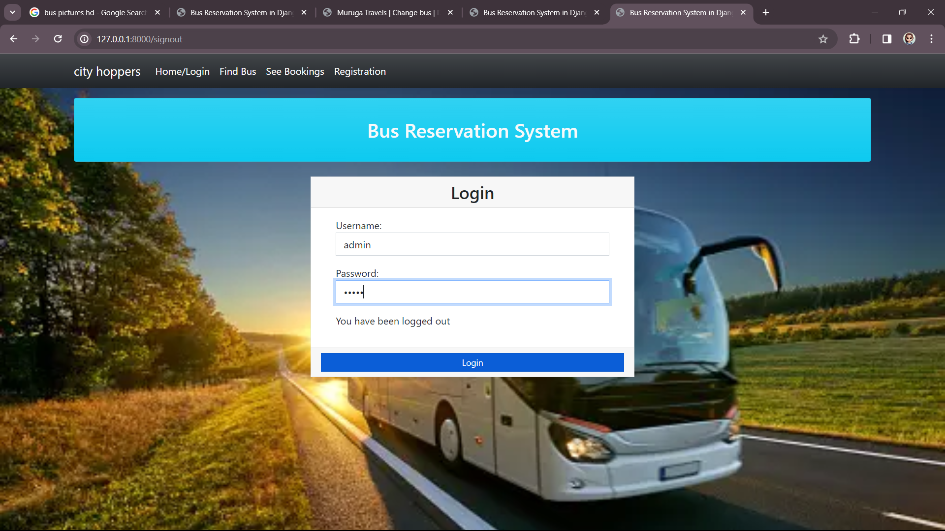
LOGIN PAGE

Slide 5
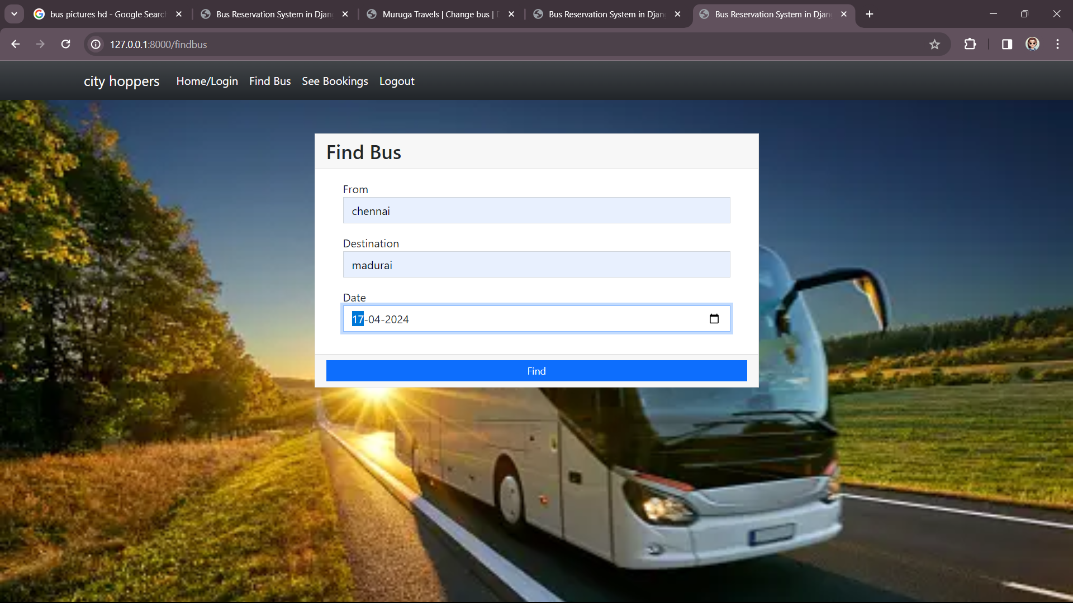
SEVICE PAGE

